Slide 1


Product Appendices

Slide 2
A modern tech stack
Proprietary tech stack for healthcare data
Serverless
PostgreSQL via PostgREST
The typical approach to delivering resilient and high uptime web services is to incur high upfront costs in server deployment and maintenance. Adopting Serverless allows us to minimise (or eliminate) upfront operational investments without losing on resilience or uptime. Serverless allows us:
To pay for our infrastructure based on usage instead of capacity;
To have transparent, zero-cost scaling beyond the first thousand or million users;
To remove the need for larger engineering and operational teams within the business;
To deploy and test new features in seconds and parallel, virtually for free.
Traditionally there is an inherent trade-off within data storage technologies between rigid relational data structures and development speed. Medical data is inherently rigid and benefits significantly from solid constraints imposed by storage mechanisms. On the other hand, startups require rapid experimentation and delivery that benefit considerably from low-constraint environments. Using PostgREST allows us to avoid this trade-off altogether. It enables us:
To prototype and deploy new features rapidly without losing the ability to introduce rigidity on crystalising parts of the data model;
To handle both data storage and access responsibilities in the same way and the same place - database migrations;
To have industry-leading standards of data security, storage, resilience and backups;
To have out-of-the-box integration with virtually every data lake system out there;
To have zero vendor lock-in. Our stack does not depend on the existence of an individual third party.

Slide 3
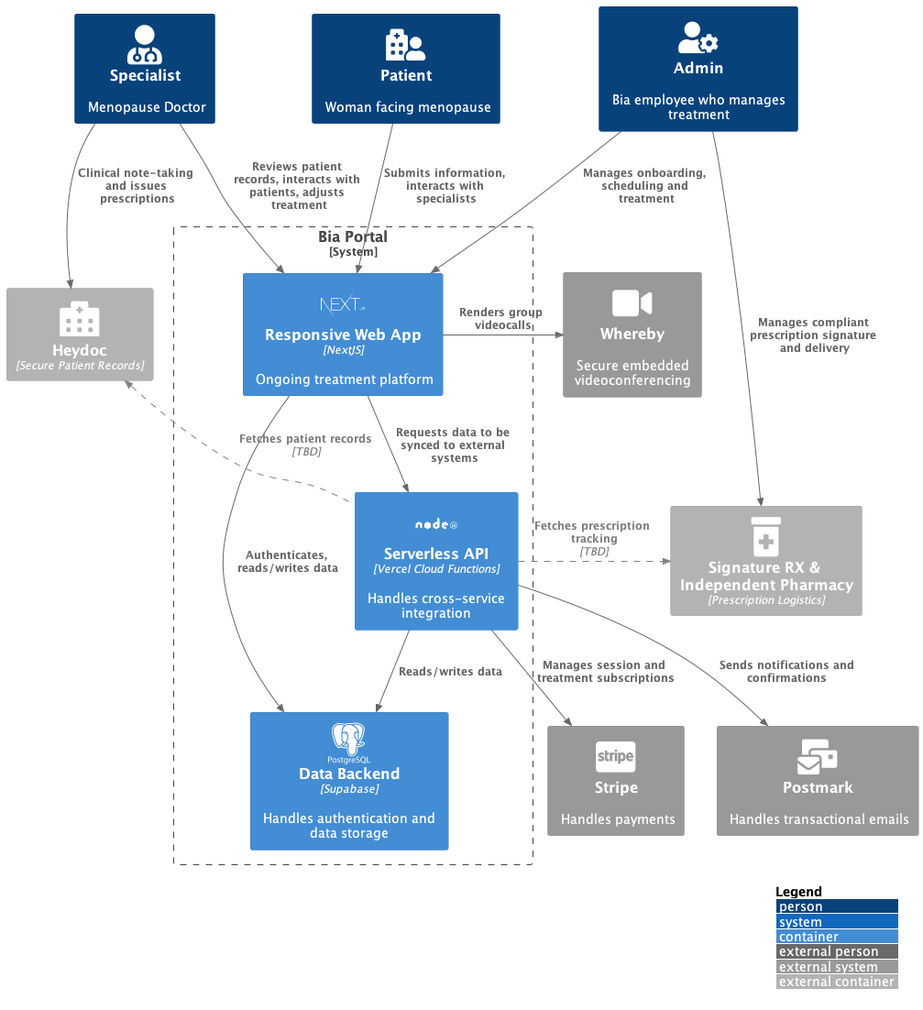
Bia’s Architecture

Slide 4
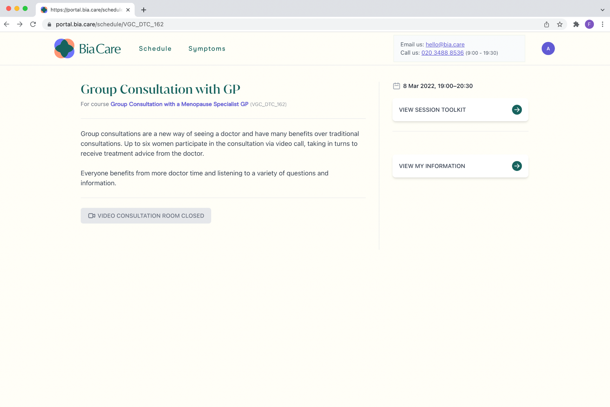
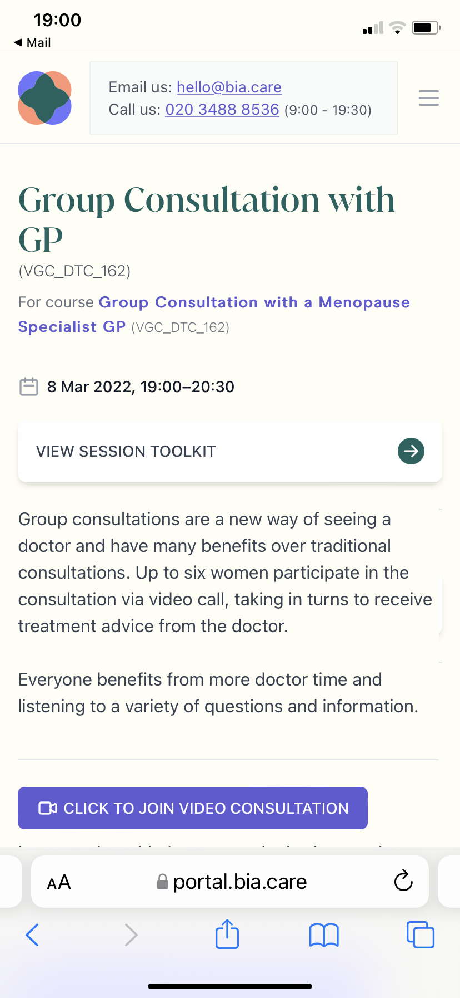
Portal: Patient view, consultation page
Patients can access session resources, edit their personal information, and join the video consultation room using our securely embedded video service.

Slide 5
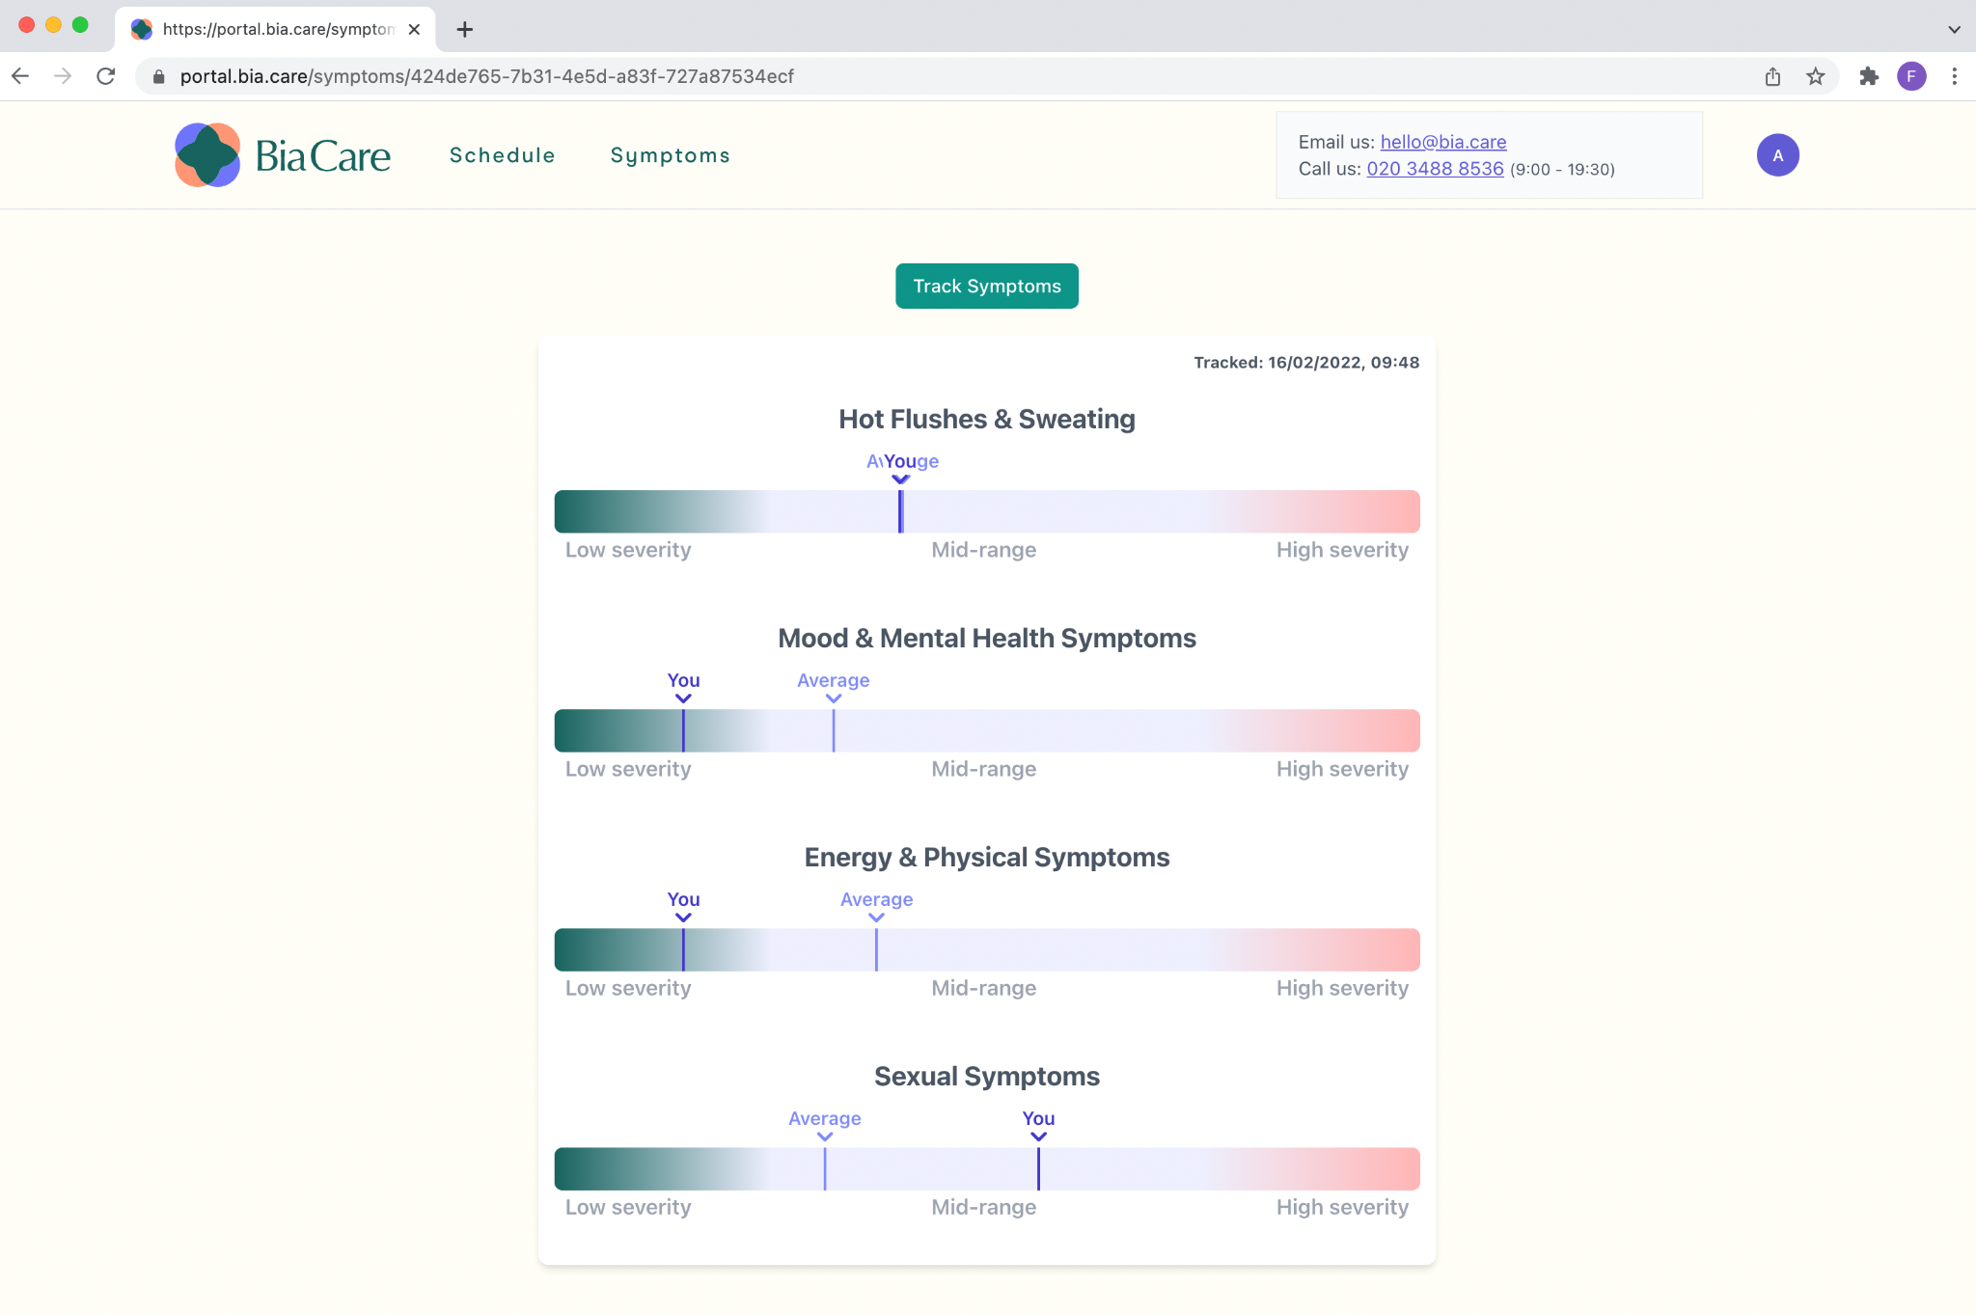
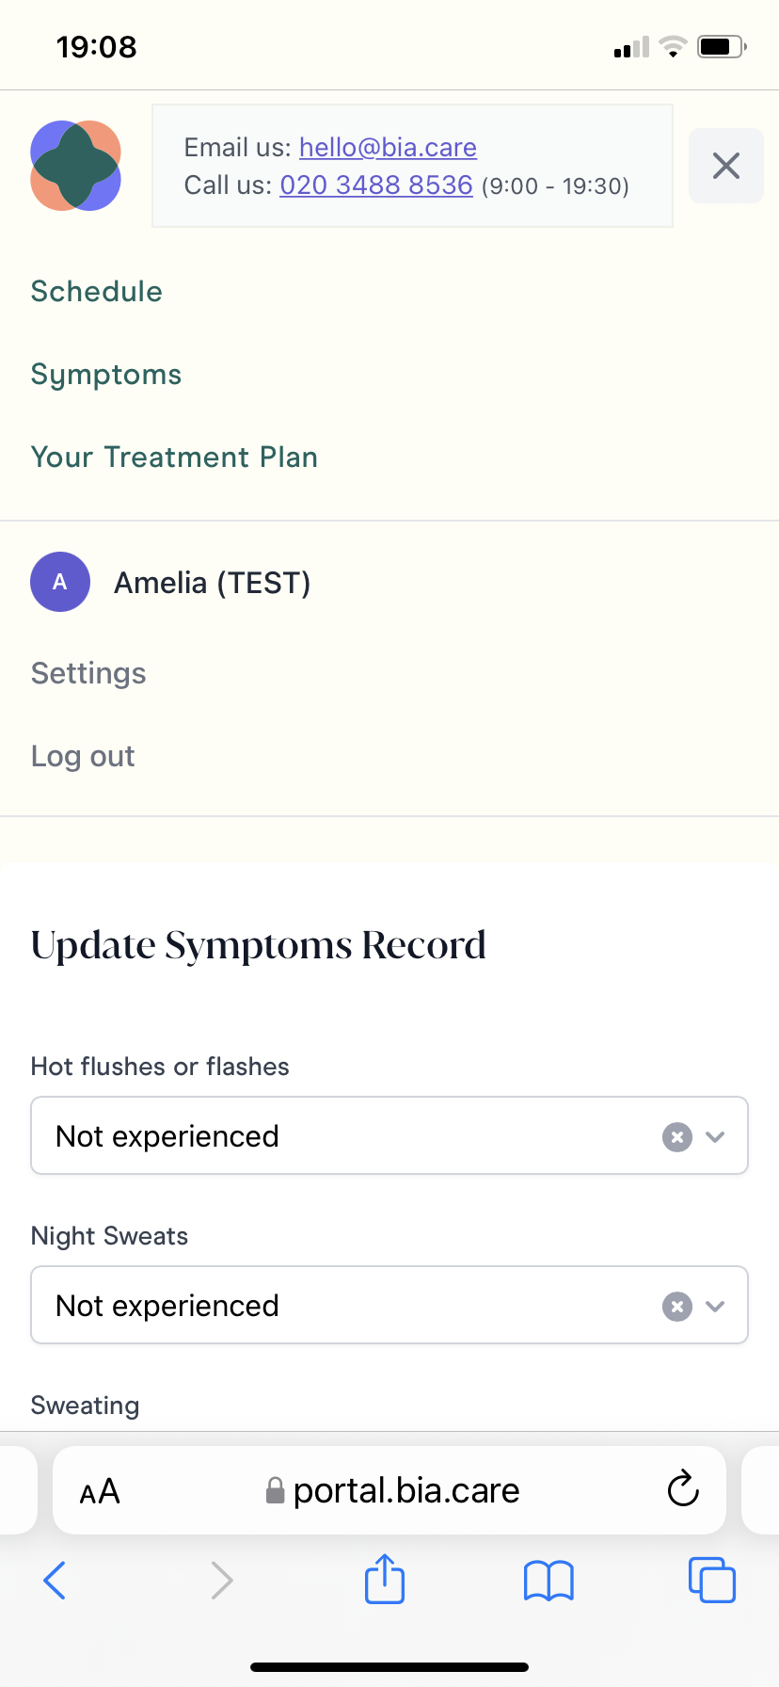
Portal: Patient view, symptom tracking
Patients can track their symptoms on web or mobile and compare severity with those of other people.

Slide 6
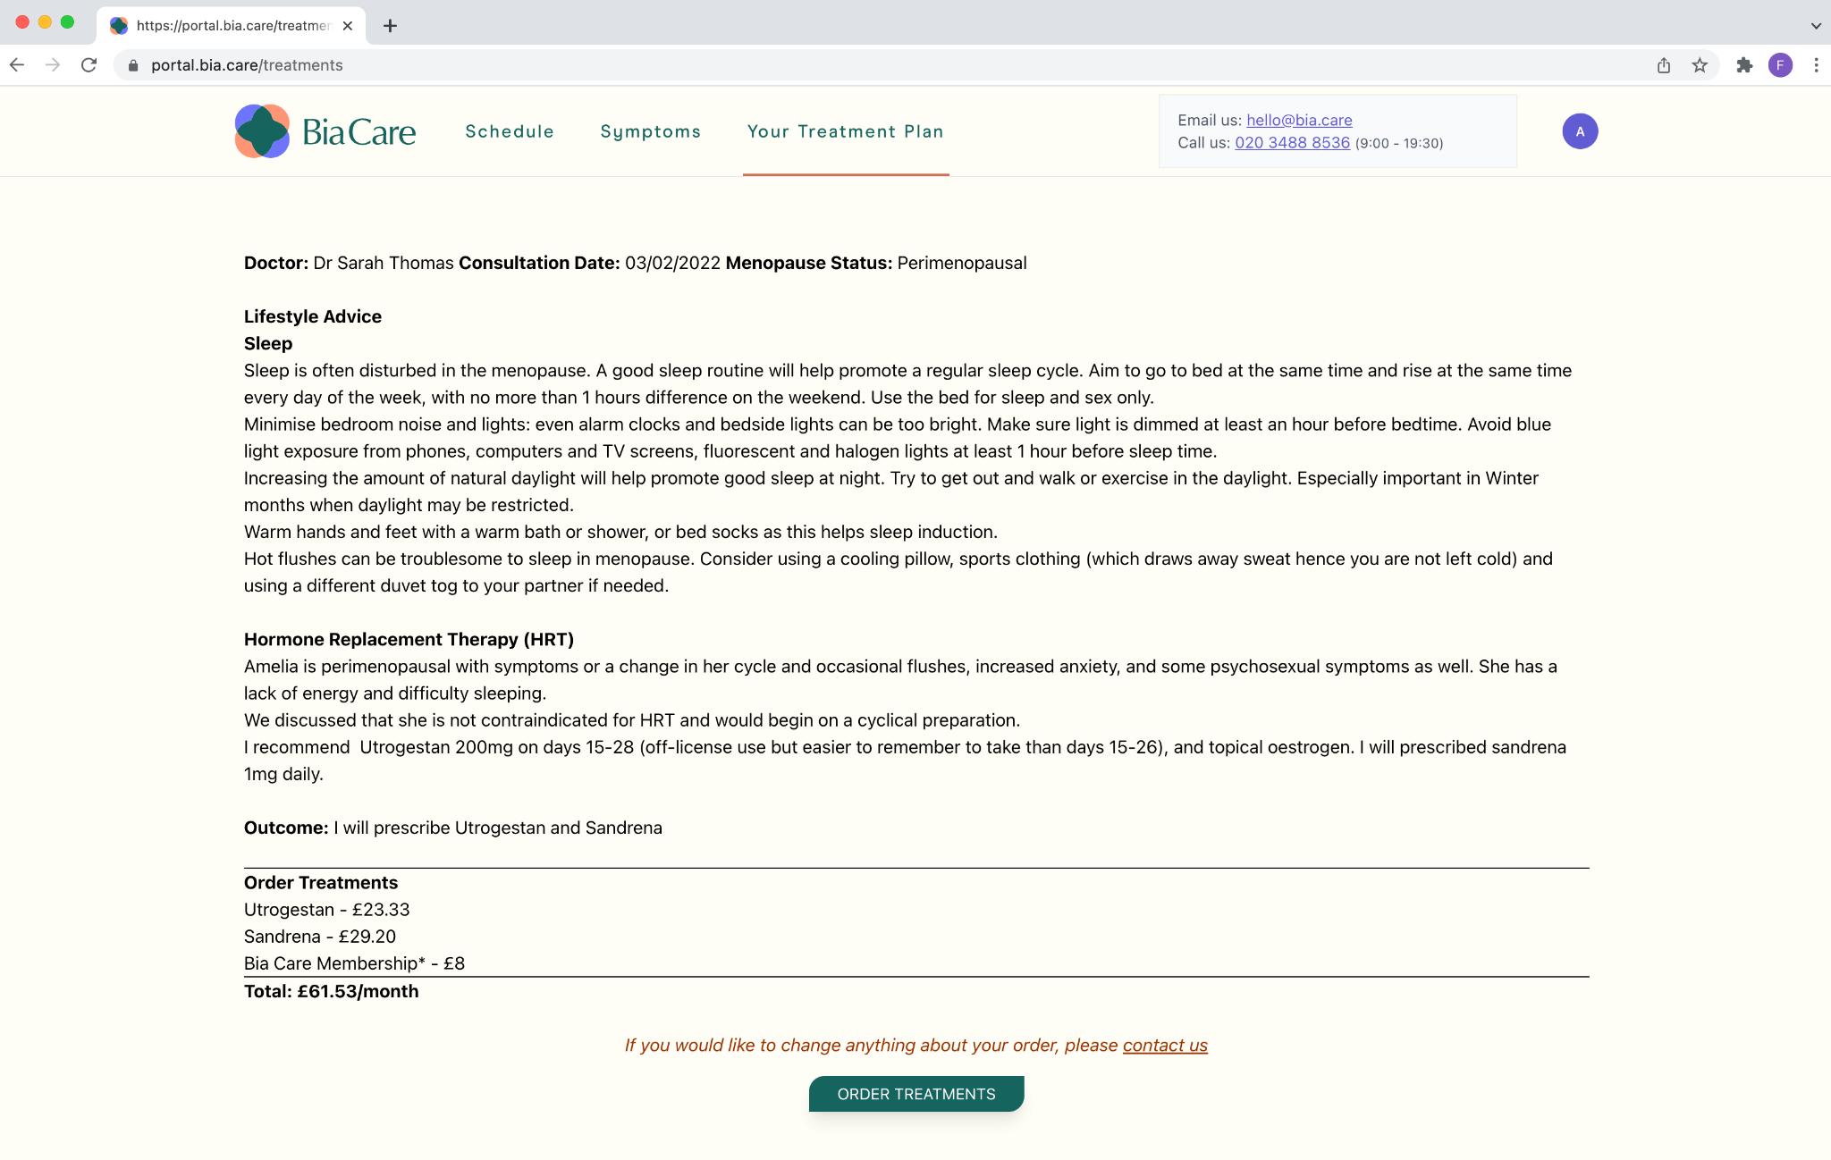
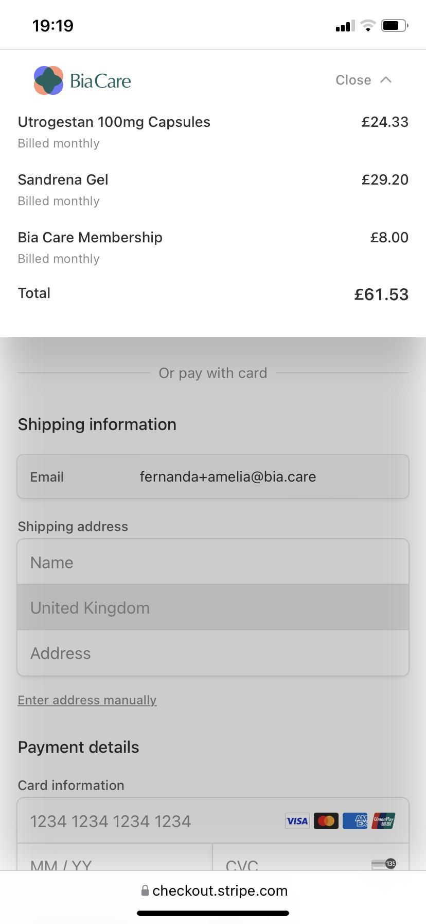
Portal: Patient view, treatment plan
Available 48 hours after a consultation, patients can review their treatment plan and order treatments directly on the portal. Medication is delivered within 48h.

Slide 7
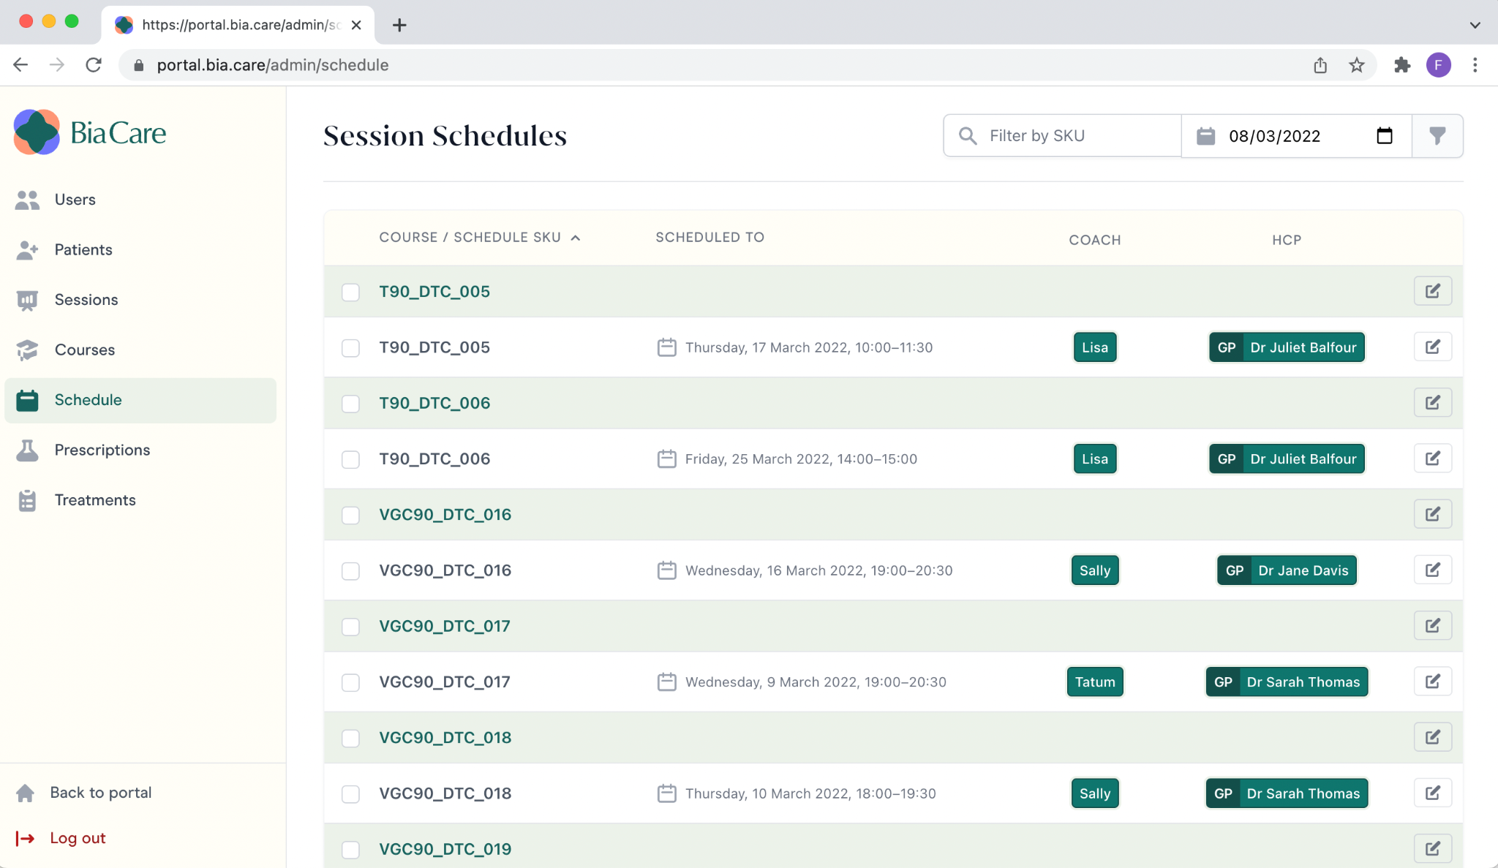
Portal: Admin view, schedules page
Bia Care admins can seamlessly schedule consultations, coordinating clinicians, health coaches, and patients.

Slide 8
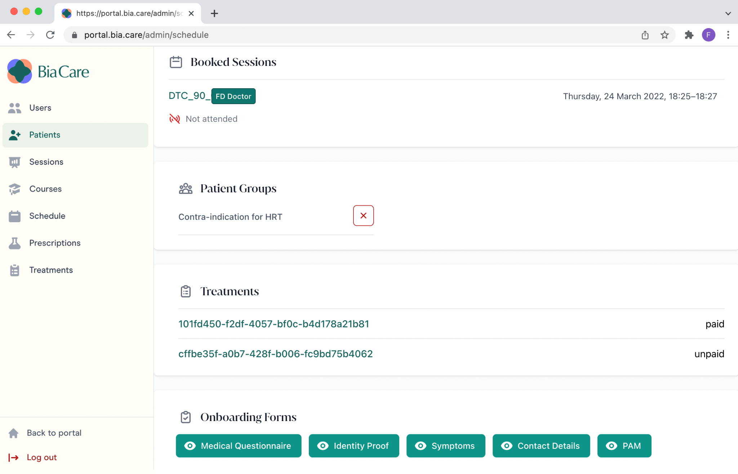
Portal: Admin view, patient page
Patients are automatically segmented into groups for their consultations. Additionally, the portal tracks attendance and treatments issued.

Slide 9
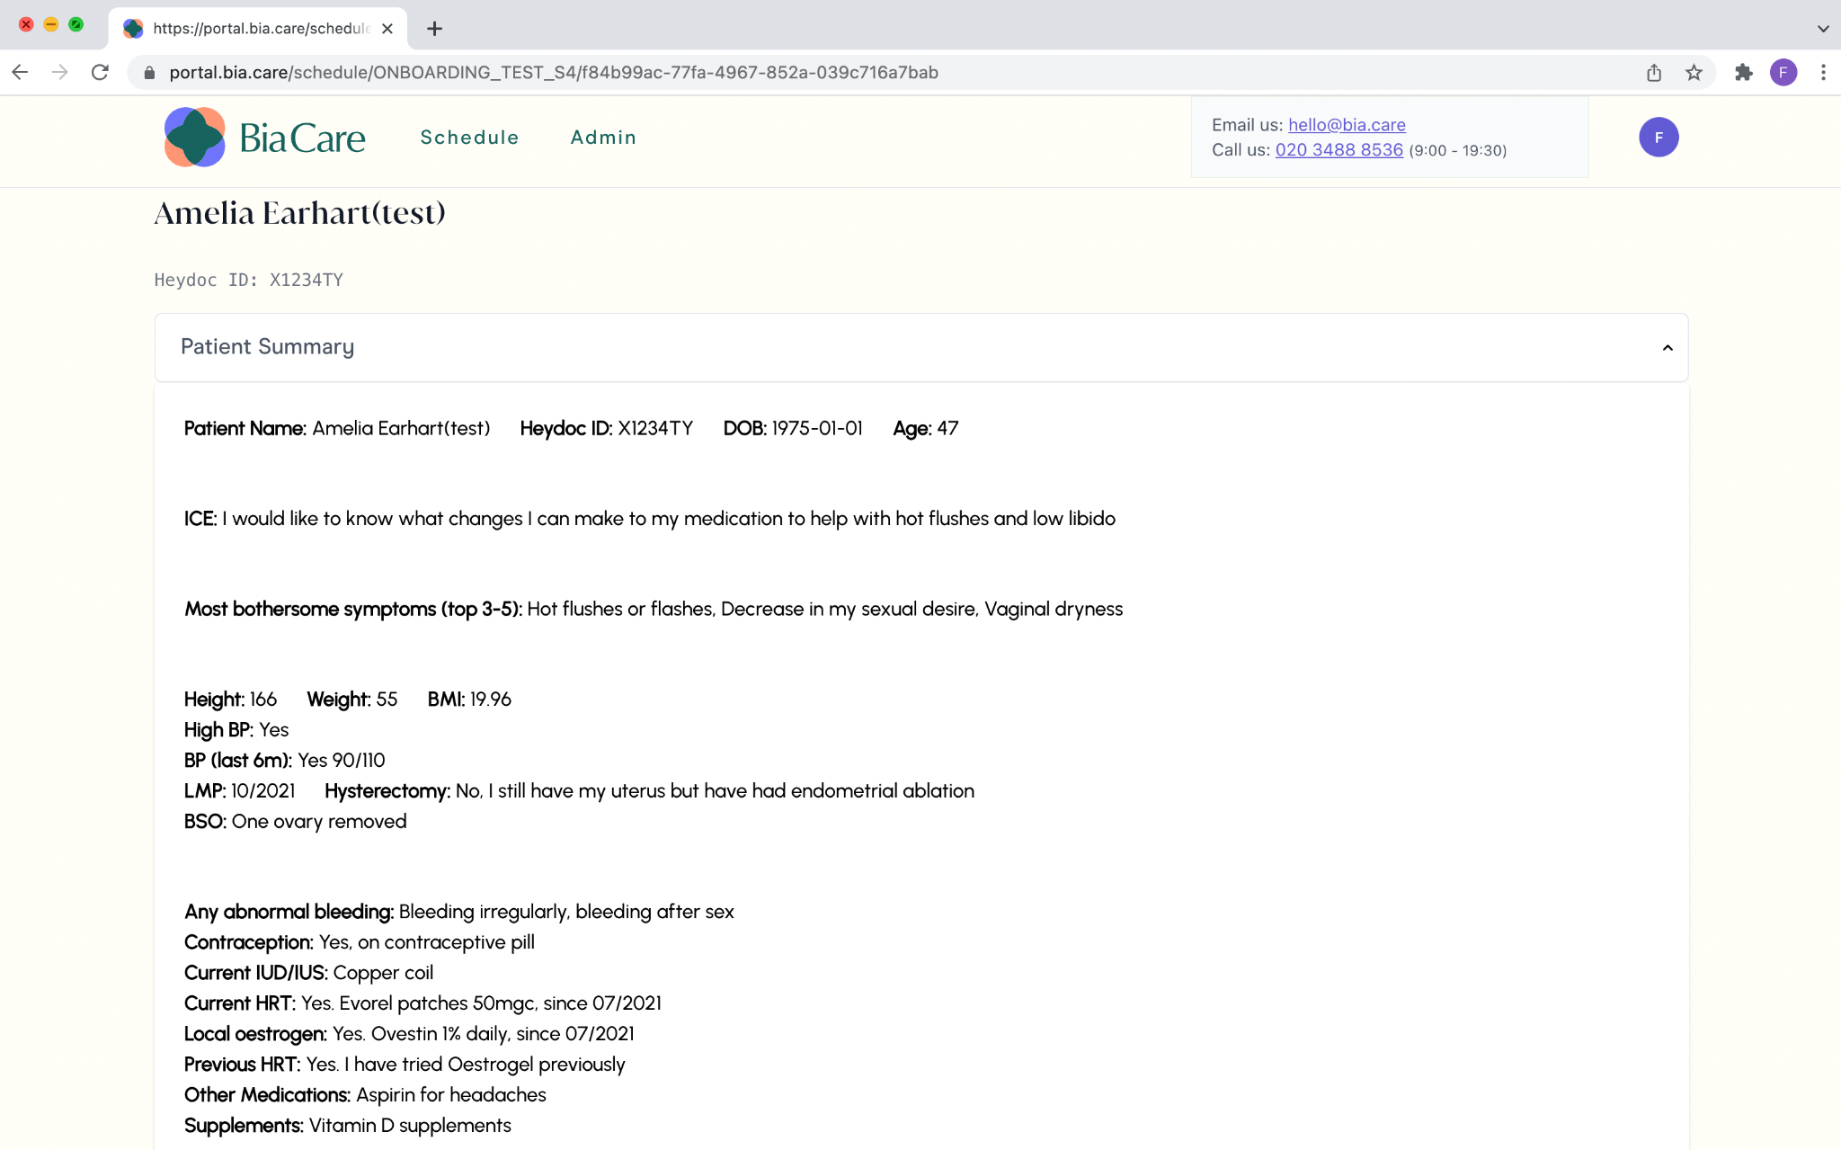
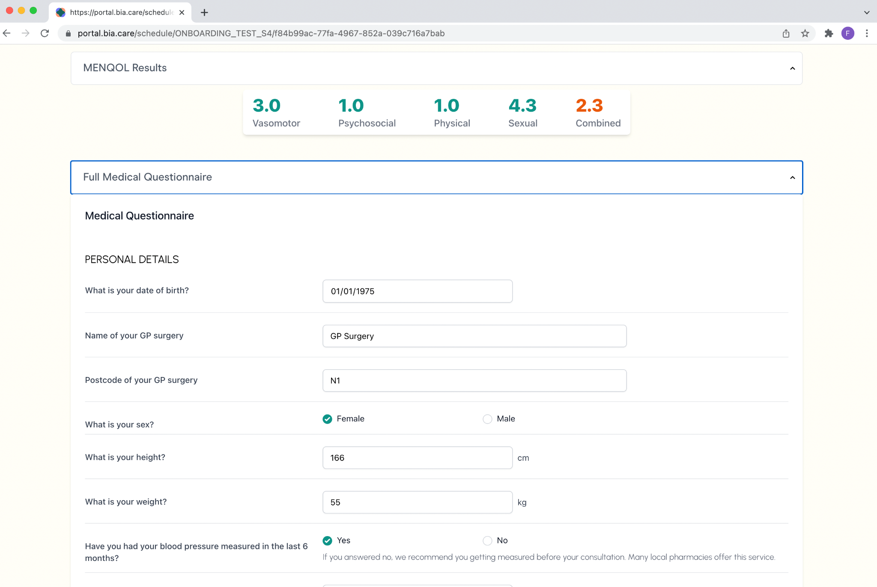
Portal: Doctor view, patient records
On Bia’s platform, clinicians have access to patient-reported outcome measures (MENQOL), symptom logs, patient’s questions and a full medical history.

Slide 10
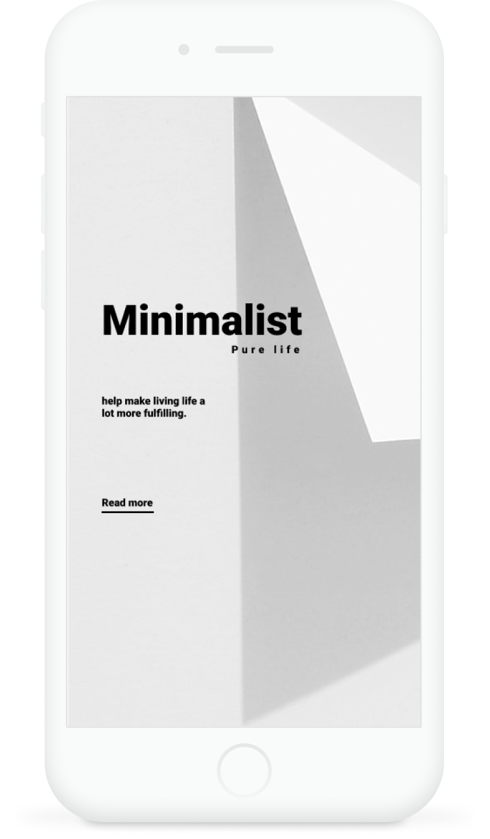
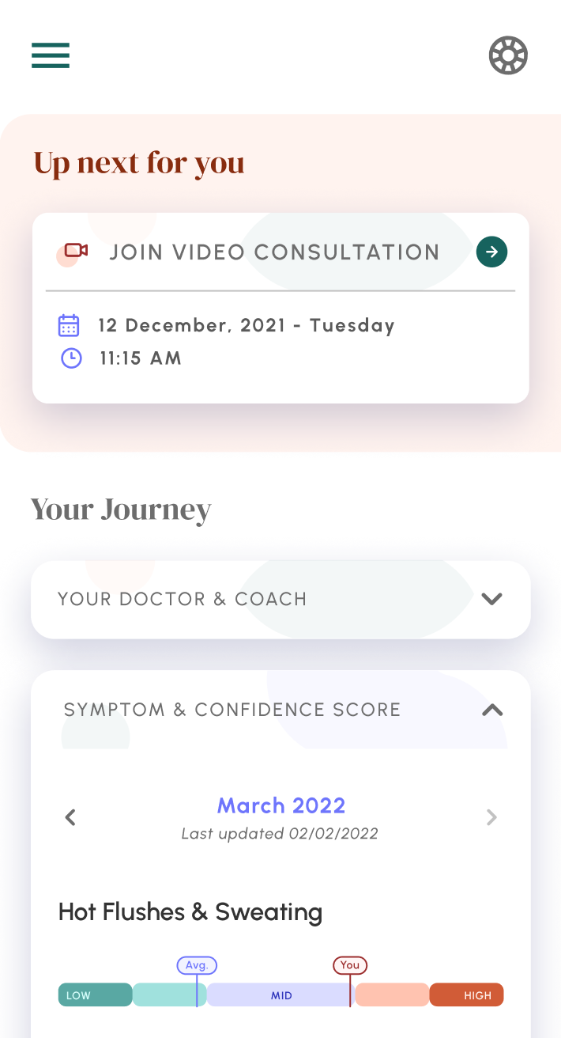
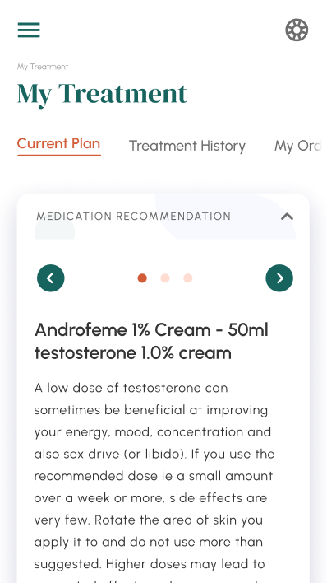
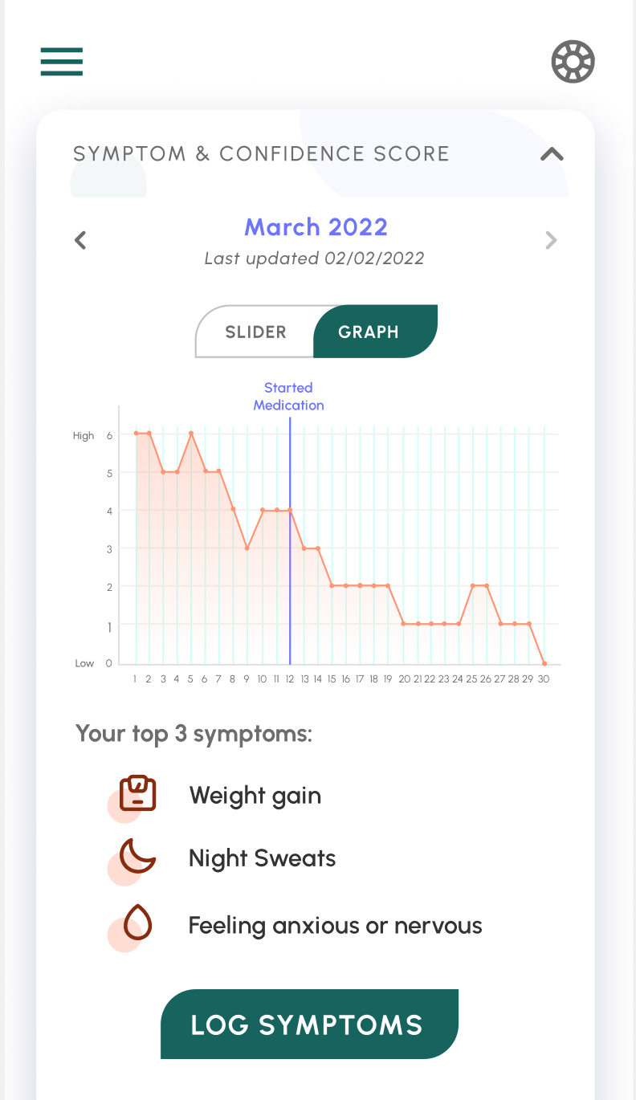
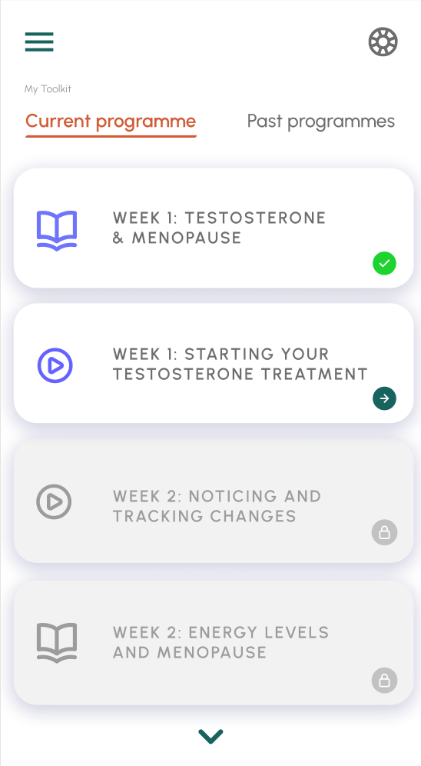
Dedicated menopause support
Dashboard
Treatment plans
Progress
Personalised programmes

Slide 11
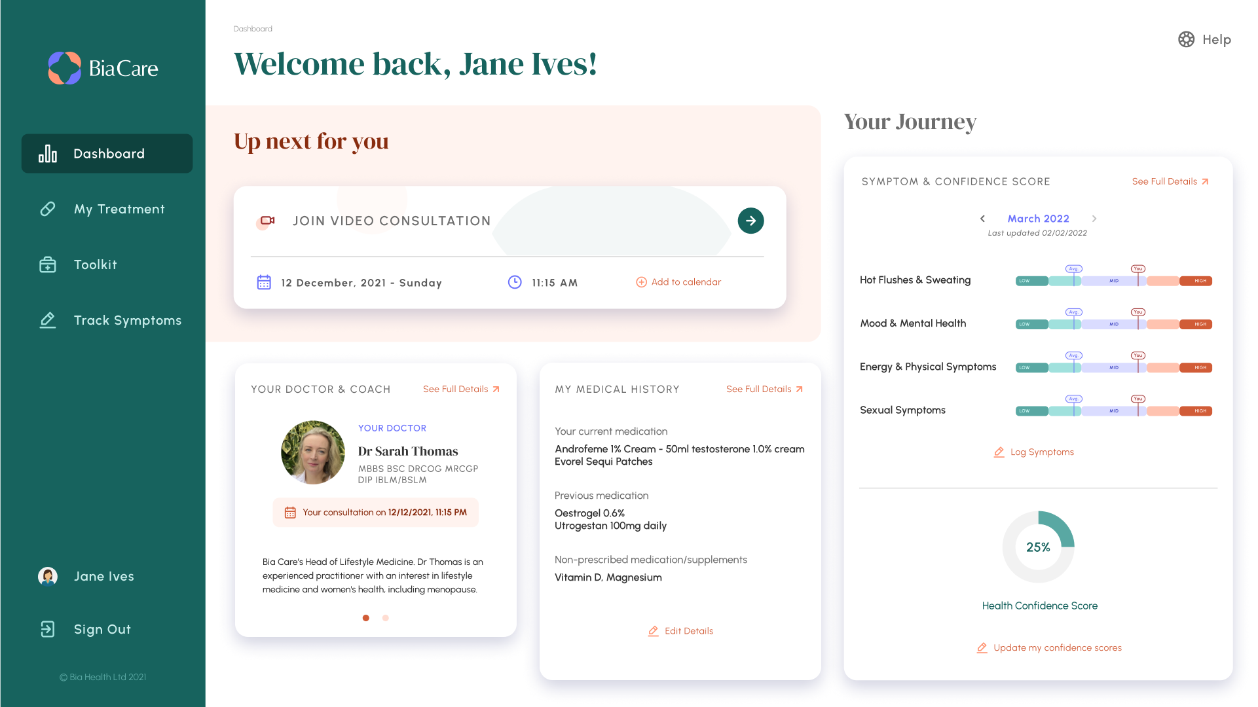
Patient dashboard (pre-consultation):
User-tested redesign following extensive customer research to prioritise activation features and data collection.

Slide 12
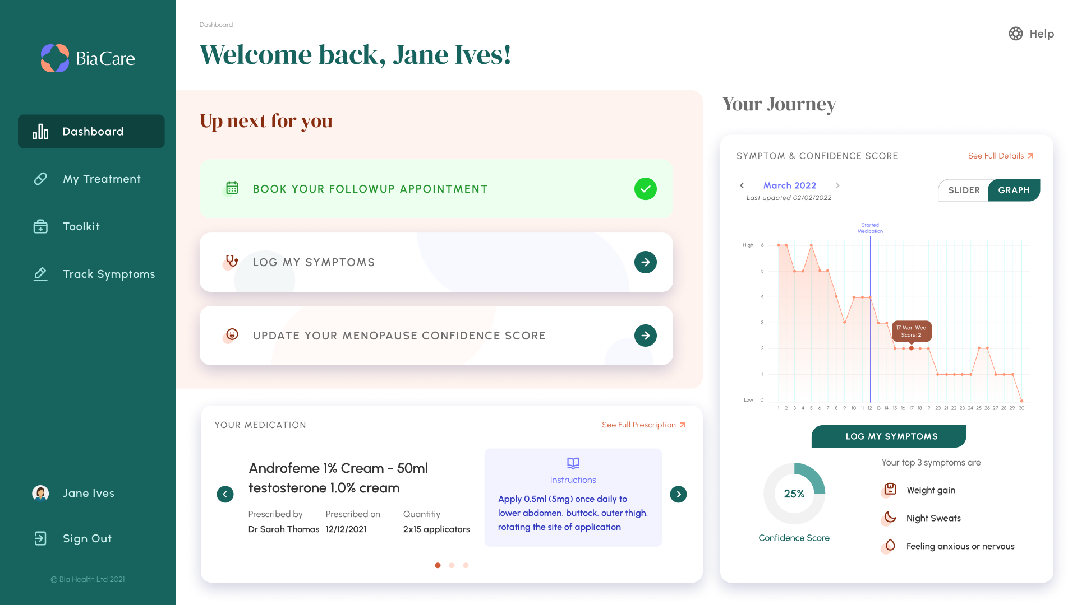
Patient dashboard:
Shows progress and insightful metrics based on aggregated data back to user at different journey points increasing engagement and treatment adherence.

Slide 13
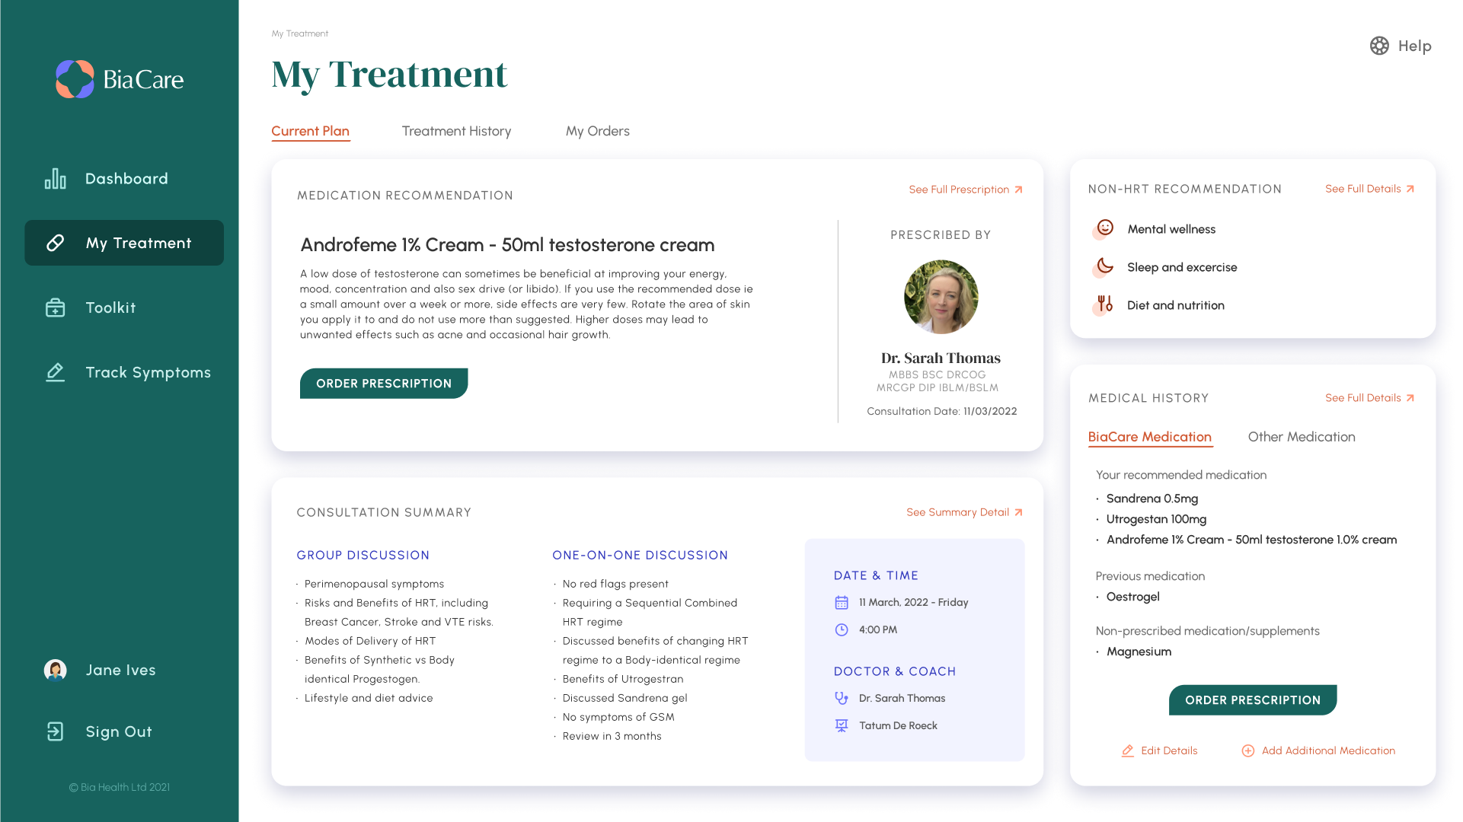
Patient treatment history:
Treatment page creates a one-stop menopause health history for patients. Including, access to guidance and support from coaches.

Slide 14
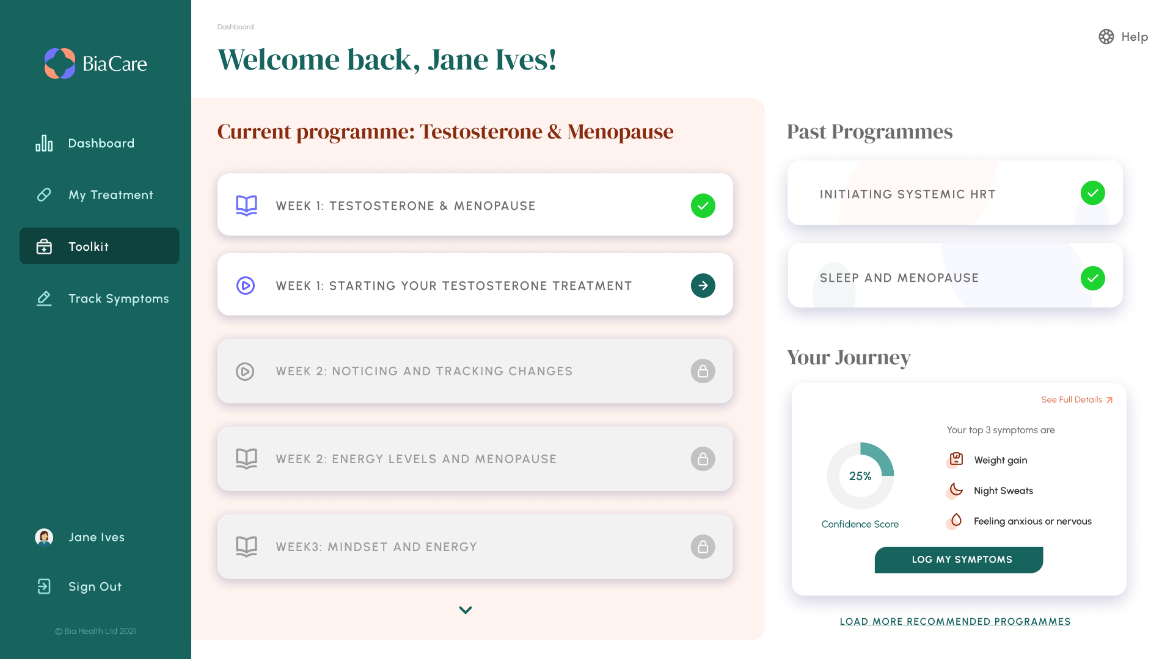
Personalised programmes
Programmes tailored to the patient, depending on treatment plan medications initiated and lifestyle medicine treatments. Unlocks weekly.

